Slide 1
Higher Degree Total Variation for 3-D Image Recovery
Greg Ongie*, Yue Hu, Mathews Jacob
Computational Biomedical Imaging Group (CBIG)
University of Iowa
ISBI 2014
Beijing, China

Slide 2
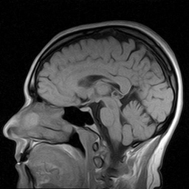
Motivation: Compressed sensing MRI recovery
Highly undersampled k-space
Use image penalty to enforce sparsity
Recon is minimizer of cost function
image penalty
k-space
recon
nonlinear optimization

Slide 3
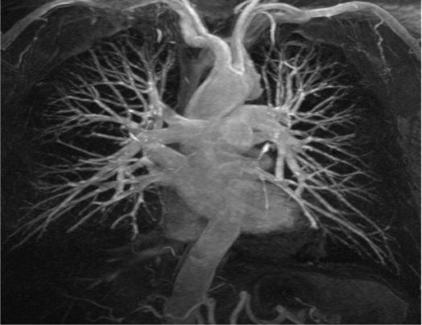
Total Variation (TV) penalty for CS-MRI
Promotes recons with sparse gradient <-> piecewise constant regions
Advantages: fast algorithms, easy to implement
Disadvantages: loss of detail at high accelerations
Ex: 3-D MRA dataset, 5-fold acceleration, random k-space samples
Fully-sampled (MIP)
TV recon, 5x accel., SNR = 13.87 dB

Slide 4
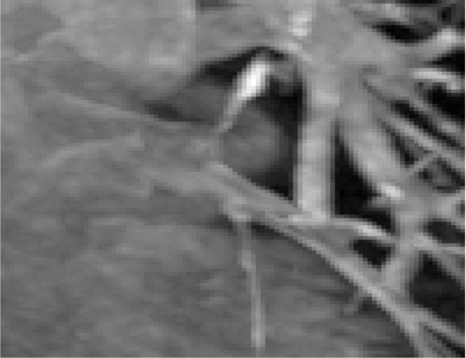
Fully-sampled (MIP)

Slide 5
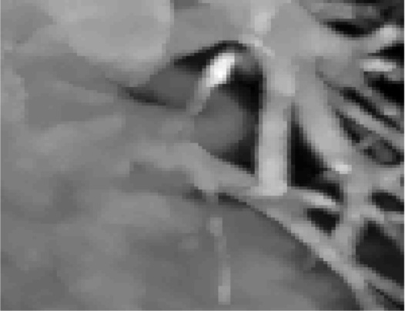
TV recon, 5x accel. (MIP)
SNR = 13.87 dB

Slide 6
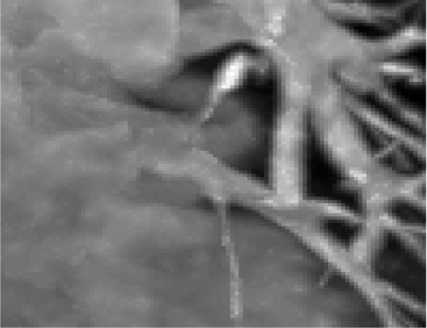
Proposed method, 5x accel. (MIP)
SNR = 14.23 dB

Slide 7
Higher Degree Total Variation (HDTV) in 2-D

Slide 8
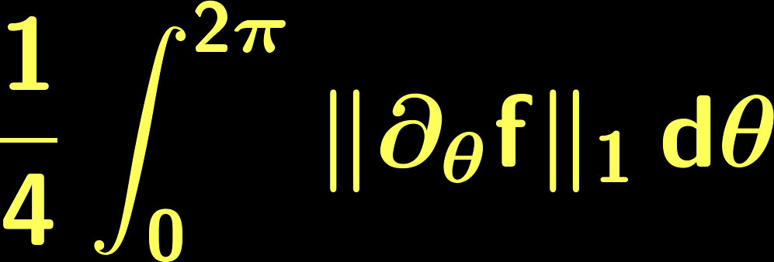
Higher Degree Total Variation (HDTV) penalties in 2-D
Family of penalties for general inverse problems
HDTV generalizes TV to higher degree derivatives
directional derivatives
L¹-norm of all n^{th} degree directional derivatives
Promotes sparse higher degree directional derivatives
Rotation- and translation-invariant, preserves edges, convex

Slide 9
Comparison of HDTV and TV in 2-D
HDTV routinely outperforms TV for many image recovery problems
Modest increases in computation time (~2-4 fold)
2-D TV Comparison. SNR (in dB) of recovered images with optimal reg. param.
(Hu et al, 2014)
 | Denoising |  | Deblurring |  | CS-MRI
 | Lena | Brain | Cell1 | Cell2 | Brain | Wrist
TV | 27.35 | 27.60 | 15.66 | 16.67 | 22.77 | 20.96
HDTV2 | 27.65 | 28.05 | 16.19 | 17.21 | 22.82 | 21.20
HDTV3 | 27.45 | 28.30 | 16.17 | 17.20 | 22.53 | 21.02
SNR vs. CPU time of HDTV and TV. (Hu, Y., & Jacob, M. , 2012)
CS-MRI, 2x accel.
CS-MRI, 4x accel.
Denoising, SNR=15dB

Slide 10
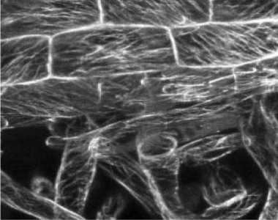
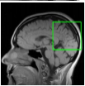
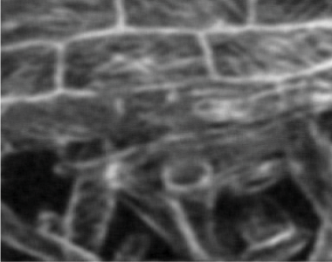
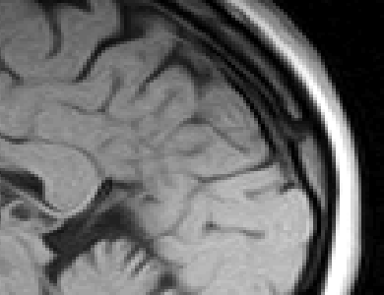
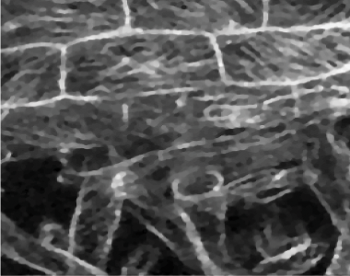
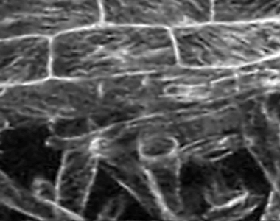
Original
Blurred + Noise
TV deblurred, SNR = 15.66 dB
HDTV2 deblurred , SNR = 16.19 dB

Slide 11
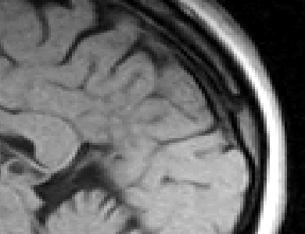
2-D CS-MRI
1.5x acceleration
random Gaussian k-space samples
Fully-sampled
TV recon, SNR = 22.77 dB
HDTV2 recon , SNR = 22.82 dB

Slide 12
HDTV2 and Hessian-Schatten Norms, (Lefkimmiatis et al., 2013)
HS_{p} = sum of L^{p}-norm of Hessian eigenvalues over all pixels
HS₁ “equivalent to” HDTV2 for real-valued images in 2-D:
Inequality only where Hessian eigenvalues have mixed sign
No equivalence when image is complex-valued, e.g. CS-MRI.
Table 2: HDTV2 vs. HS₁. SNR (in dB) of recovered images with optimal reg. param.
 | Denoising |  | Deblurring |  | CS-MRI
 | Lena | Brain | Cell1 | Cell2 | Brain | Wrist
HDTV2 | 27.65 | 28.05 | 16.19 | 17.21 | 22.82 | 21.20
HS1 | 27.51 | 28.08 | 16.17 | 17.13 | 22.50 | 20.51

Slide 13
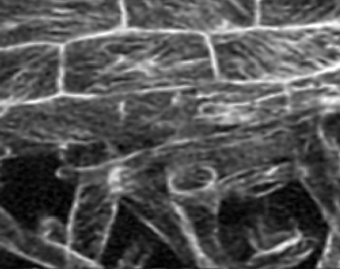
HDTV2 and Hessian-Schatten Norms, (Lefkimmiatis et al., 2013)
HS_{p} = sum of L^{p}-norm of Hessian eigenvalues over all pixels
HS₁ “equivalent to” HDTV2 for real-valued images in 2-D:
Inequality only where Hessian eigenvalues have mixed sign
No equivalence when image is complex-valued, e.g. CS-MRI.
Deblurring of 2-D Cell Florescence Microscopy Image
Table 2: HDTV2 vs. HS₁. SNR (in dB) of recovered images with optimal reg. param.
 | Denoising |  | Deblurring |  | CS-MRI
 | Lena | Brain | Cell1 | Cell2 | Brain | Wrist
HDTV2 | 27.65 | 28.05 | 16.19 | 17.21 | 22.82 | 21.20
HS1 | 27.51 | 28.08 | 16.17 | 17.13 | 22.50 | 20.51
Blurred + Noise
HDTV2, SNR =16.19 dB
HS1, SNR =16.17 dB

Slide 14
HDTV2 and Hessian-Schatten Norms, (Lefkimmiatis et al., 2013)
HS_{p} = sum of L^{p}-norm of Hessian eigenvalues over all pixels
HS₁ “equivalent to” HDTV2 for real-valued images in 2-D:
Inequality only where Hessian eigenvalues have mixed sign
No equivalence when image is complex-valued, e.g. CS-MRI.
Table 2: HDTV2 vs. HS₁. SNR (in dB) of recovered images with optimal reg. param.
 | Denoising |  | Deblurring |  | CS-MRI
 | Lena | Brain | Cell1 | Cell2 | Brain | Wrist
HDTV2 | 27.65 | 28.05 | 16.19 | 17.21 | 22.82 | 21.20
HS1 | 27.51 | 28.08 | 16.17 | 17.13 | 22.50 | 20.51
Why use HDTV?
Easily adaptable to complex-valued images
Extends to higher degree deriatives (n > 2)

Slide 15
Extension of HDTV to 3-D

Slide 16
Extension of HDTV to 3-D
L¹–norm of all n^{th} degree directional derivatives in 3-D
u
surface integral over unit sphere
Problem: How to implement this efficiently for inverse problems?
Discretize integral using an efficient quadrature
Exploit steerability of directional derivatives
Employ a fast alternating minimization algorithm

Slide 17
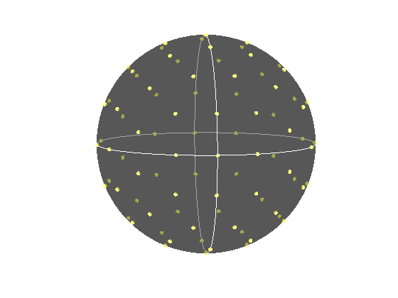
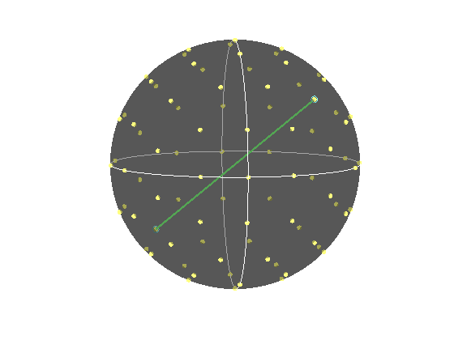
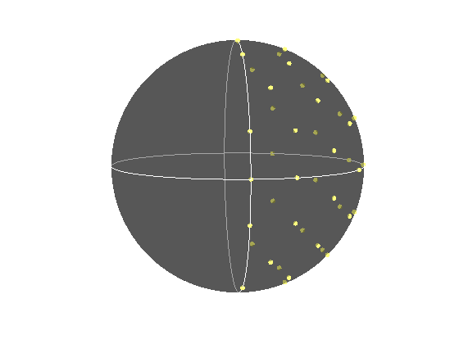
1. Discretize integral using an efficient quadrature
Quadrature of sphere: {unit-directions u_{i} and weights w_{i ,} i=1,…,K }
Lebedev quadrature: efficient, symmetric (Lebedev & Laikov, 1999)
Exploits symmetry of directional derivatives:
u_{i}
K = 86 samples
Identify antipodal points
K/2 = 43 samples
Numerical experiments show that 30-50 samples are sufficient

Slide 18
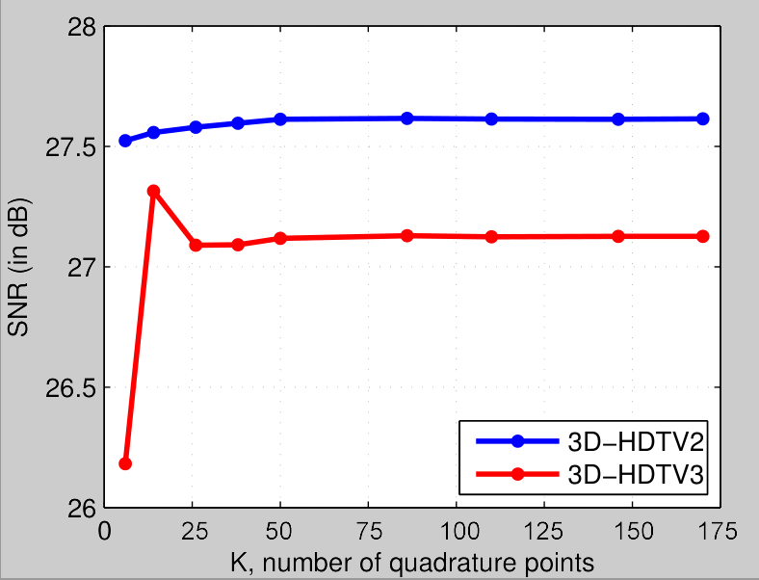
SNR vs. #quadrature points in a denoising experiment

Slide 19
2. Exploit steerability of directional derivatives
HD directional derivatives are weighted sum of partial derivatives
Significantly reduces # filtering operations: 6 for HDTV2, 10 for HDTV3
Ex: 2nd degree dir. derivative
Compute discrete partial derivatives with finite differences
Obtain all K dir. derivatives with matrix multiplication O(KN), N= # voxels.

Slide 20
3. Employ a fast alternating minimization algorithm
Adapt a new fast algorithm for 2-D HDTV
Based on variable splitting and quadratic penalty method
Linear Inverse Problem with 3-D HDTV regularization
z-subproblem: shrinkage of directional derivatives
z-subproblem: shrinkage of directional derivatives
x-subproblem: invert linear system → FFTs or CG

Slide 21
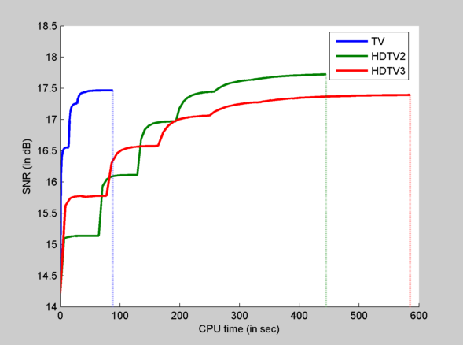
Estimated computation time
CS-MRI recovery experiment @1.6x acceleration
256x256x76 dataset
MATLAB implementation running on CPU (Intel Xeon 3.6 GHz, 4 cores)
Running time:
TV: 1.5 minutes
HDTV2: 7.5 minutes
HDTV3: 10 minutes

Slide 22
Results

Slide 23
3-D Quantitative Results
Table 3: 3-D Comparisons. SNR (in dB) of recovered images with optimal reg. param.
 | Denoising |  | Deblurring |  |  | CS-MRI
 | Cell1 | Cell2 | Cell1 | Cell2 | Cell3 | Angio, acc=5 | Angio, acc=1.5 | Cardiac
TV | 17.12 | 16.25 | 19.02 | 16.43 | 14.50 | 13.87 | 14.53 | 18.37
HDTV2 | 17.25 | 16.70 | 19.15 | 16.60 | 14.87 | 14.23 | 15.11 | 18.56
HDTV3 | 17.68 | 17.14 | 19.73 | 17.43 | 15.23 | 14.01 | 14.70 | 18.50
HDTV outperforms TV in all experiments
HDTV3 better for denoising and deblurring
HDTV2 better for CS-MRI

Slide 24
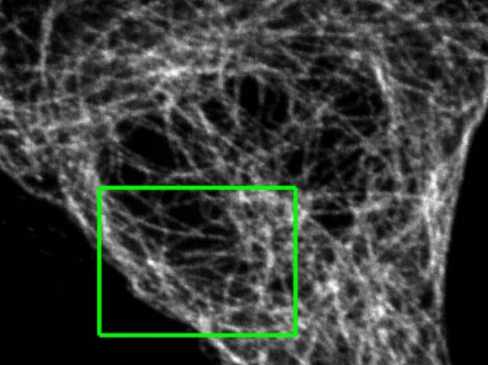
Denoising of 3-D Florescence Microscopy
1024x1024x17 voxels
Additive Gaussian noise, mean = 0, std. dev. = 1
Noisy image has SNR = 15 dB
Optimized regularization parameter
original dataset (z-slice)

Slide 25
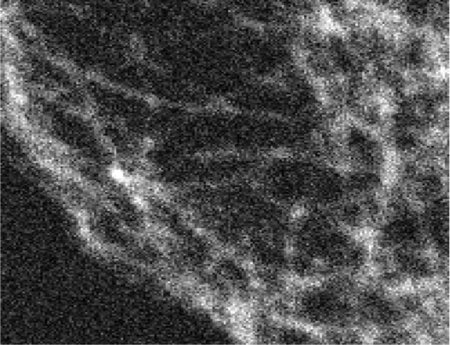
Noisy (slice, zoomed)

Slide 26
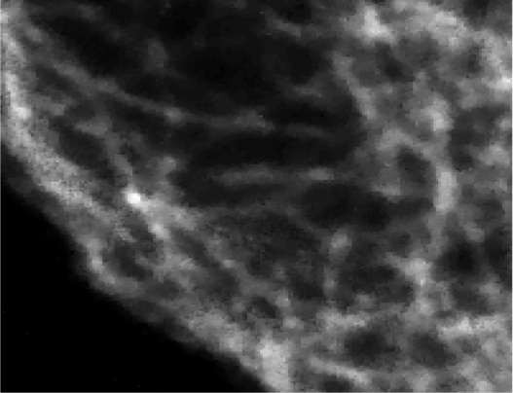
TV denoised (slice, zoomed)
SNR = 16.25 dB

Slide 27
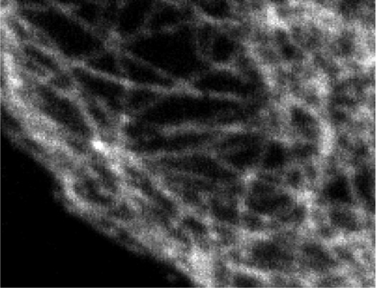
HDTV3 denoised (slice, zoomed)
SNR = 17.14 dB

Slide 28
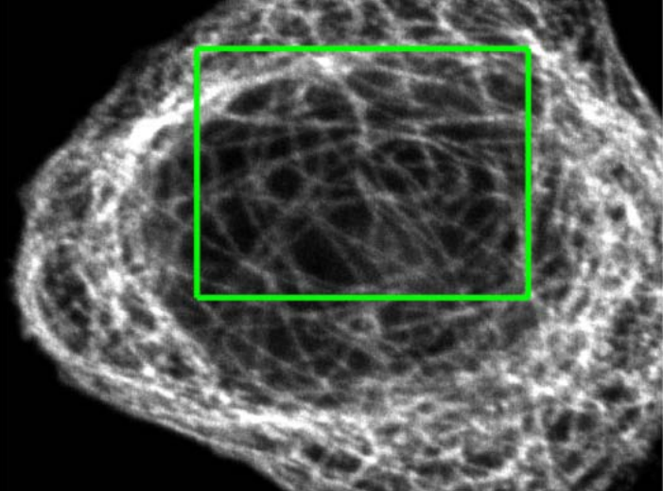
Deblurring of 3-D Florescence Microscopy
1024x1024x17 voxels
3x3x3 Gaussian blur kernel, std. dev = 0.05
5 dB additive Gaussian noise
Optimized regularization parameter
original dataset (z-slice)

Slide 29
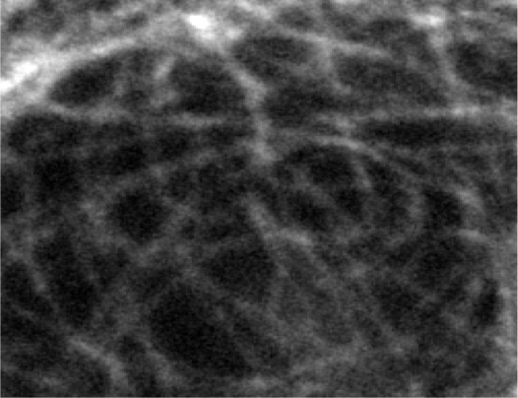
Blurred + Noisy (slice, zoomed)

Slide 30
TV deblurred (slice, zoomed)
SNR = 14.50 dB

Slide 31
HDTV3 deblurred (slice, zoomed)
SNR = 15.23 dB

Slide 32
3-D Compressed Sensing MRA
512x512x76 voxel MRA dataset obtained from physiobank (see ref. [6])
Simulated single coil acquisition
Retroactively undersampled at 1.5-fold acceleration
Random Gaussian sampling of k-space
5 dB additive Gaussian noise
Optimized regularization parameter
MIP of original MRA dataset

Slide 33
b
a
Fully-sampled (MIP)

Slide 34
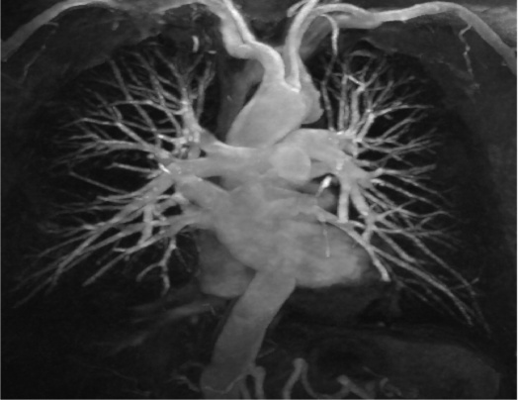
b
a
TV recon, 1.5x accel. (MIP)
SNR = 14.53 dB

Slide 35
b
a
HDTV2 recon, 1.5x accel. (MIP)
SNR = 15.11 dB

Slide 36
a
Fully-sampled (MIP)

Slide 37
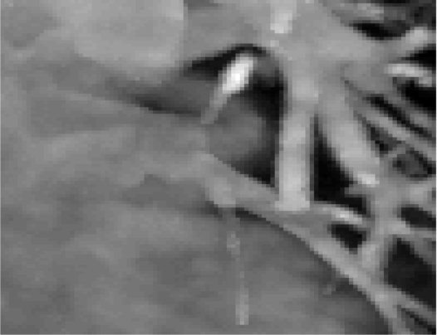
a
TV recon, 1.5x accel. (MIP)
SNR = 13.87 dB

Slide 38
a
HDTV2 recon, 1.5x accel. (MIP)
SNR = 14.23 dB

Slide 39
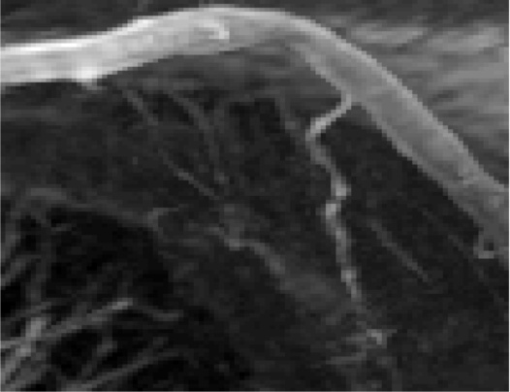
b
Fully-sampled (MIP)

Slide 40
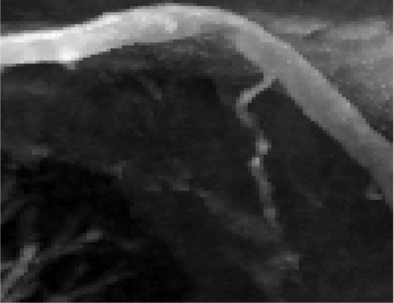
b
TV recon, 1.5x accel. (MIP)
SNR = 14.53 dB

Slide 41
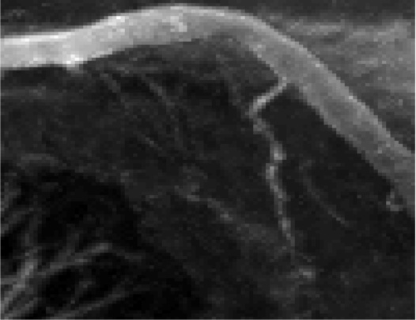
b
HDTV2 recon, 1.5x accel. (MIP)
SNR = 15.11 dB

Slide 42
Conclusion

Slide 43
Summary
We extended the HDTV penalties to 3-D
Implemented efficiently: quadrature, steerabililty, alternating minimize
HDTV outperformed TV in our 3-D image recovery experiments
3-D HDTV2 showed promising application to CS-MRI recovery
3-D HDTV3 denoising and deblurring

Slide 44
Code
MATLAB implementation available at:
CBIG Website: http://research.engineering.uiowa.edu/cbig
http://github.com/cbig-iowa/hdtv
plug-in for 3-D HDTV denoising (in development)

Slide 45
Acknowledgements
Thank You!
Hans Johnson
Supported by grants: NSF CCF-0844812, NSF CCF-1116067, NIH 1R21HL109710-01A1, ACS RSG-11-267-01-CCE, and ONR-N000141310202.
References
[1] Hu, Y., & Jacob, M. (2012). HDTV regularization for image recovery. IEEE TIP, 21(5), 2559-2571
[2] Hu, Y., Ongie, G., Ramani, S., & Jacob, M. (2014). Generalized Higher degree total variation (HDTV). IEEE TIP (in press).
[3] Lefkimmiatis, S., Ward, J. P., & Unser, M. (2013). Hessian Schatten-Norm Regularization for Linear Inverse Problems. IEEE TIP, 22, 1873-1888.
[5] V.I. Lebedev, and D.N. Laikov (1999). A quadrature formula for the sphere of the 131st algebraic order of accuracy. Doklady Mathematics, Vol. 59, No. 3, pp. 477-481.
[6] Physiobank: http://physionet.org/physiobank/database/images/,

Slide 46
Higher Degree Total Variation for 3-D Image Recovery
TV
HDTV
Code: http://research.engineering.uiowa.edu/cbig http://github.com/cbig-iowa/hdtv
Contact Info: Greg Ongie ( gregory-ongie@uiowa.edu ) Graduate Research Assistant
Computational Biomedical Imaging Group Department of Mathematics
University of Iowa
14 MacLean Hall
Iowa City, Iowa 52245

